Slide 1
HOME SECURITY SYSTEM
MADE BY:
Archana -16BCE1290

Slide 2
ABSTRACT
In this project, we will build a Home Security System using PIR Sensor and Pi Camera. This system will detect the presence of Intruder and quickly alert the user by sending him an alert mail. This mail will also contain the Picture of the Intruder, captured by Pi camera. Raspberry Pi is used to control the whole system. This system can be installed at the main door of your home or office and you can monitor it from anywhere in the world using your Email over internet.

Slide 3
Components Used
HARDWARE:
Raspberry Pi
Pi Camera
PIR Sensor
LED
Bread Board
Resistor (1k)
Connecting wires
Power supply

Slide 4
Components Used
SOFTWARE:
Raspbian OS
Python IDLE 3
CLOUD:
Microsoft Azure

Slide 5
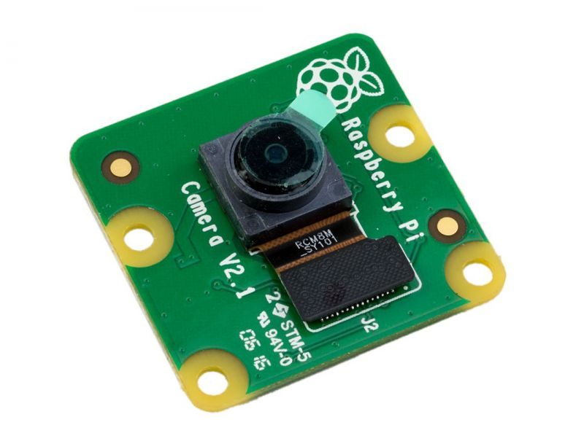
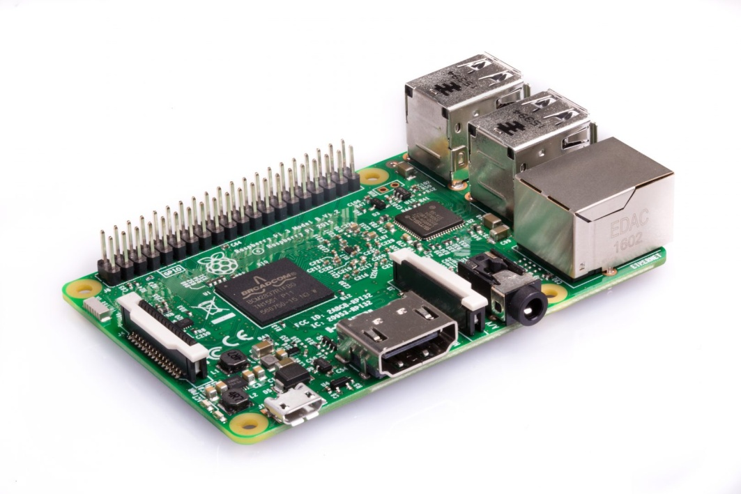
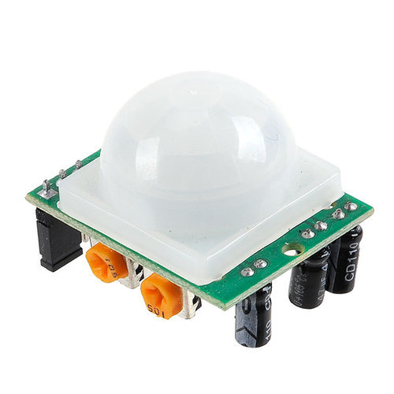
Pi Camera
Raspberry Pi 3
PIR Sensor

Slide 6
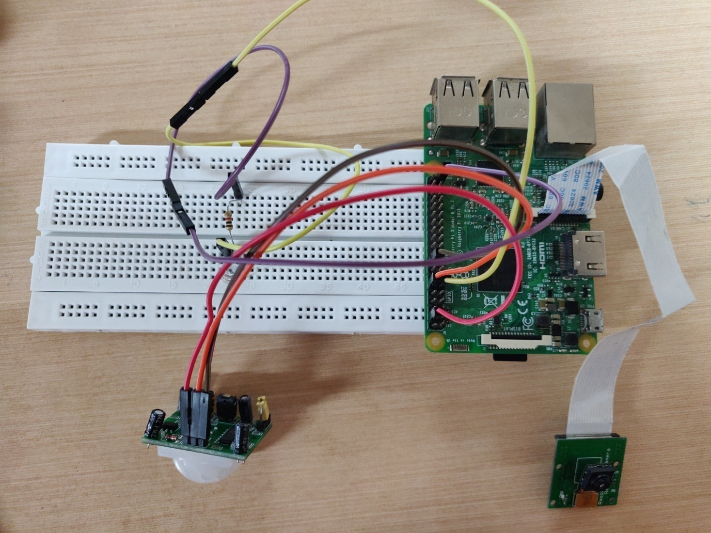
CIRCUIT DIAGRAM

Slide 7
IMPLEMENTATION

Slide 8
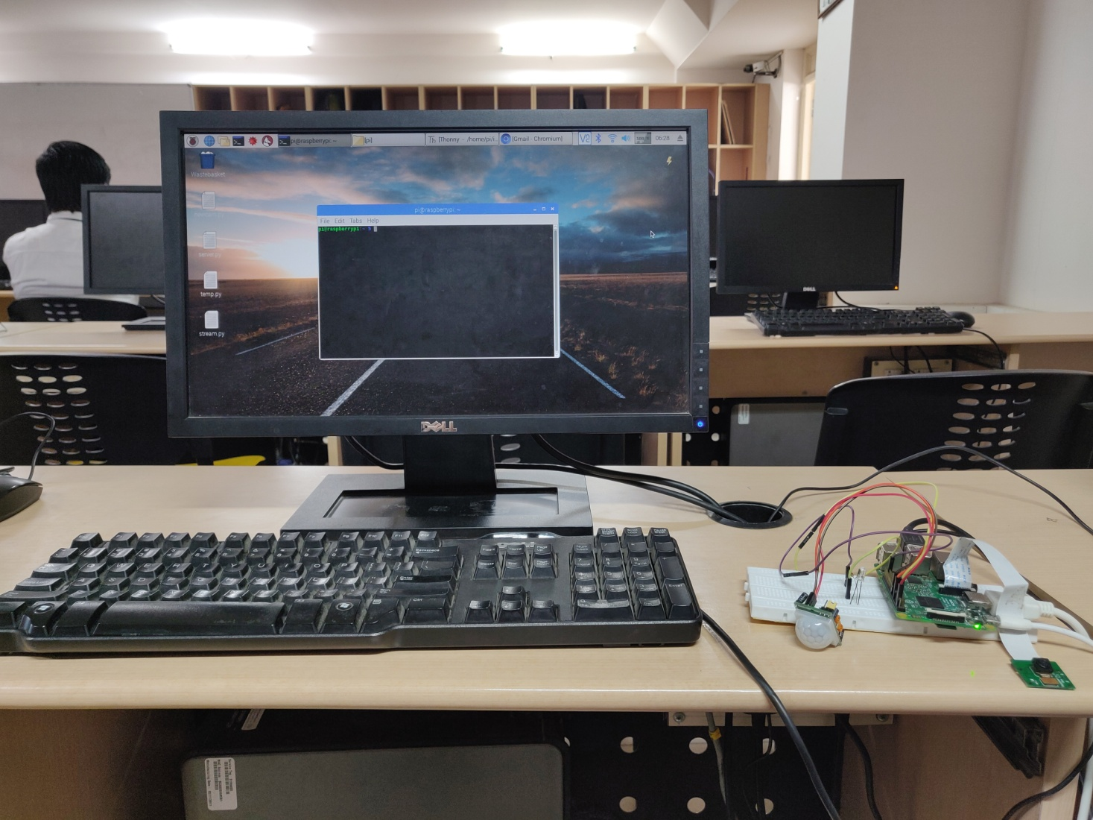
INTERFACE

Slide 9
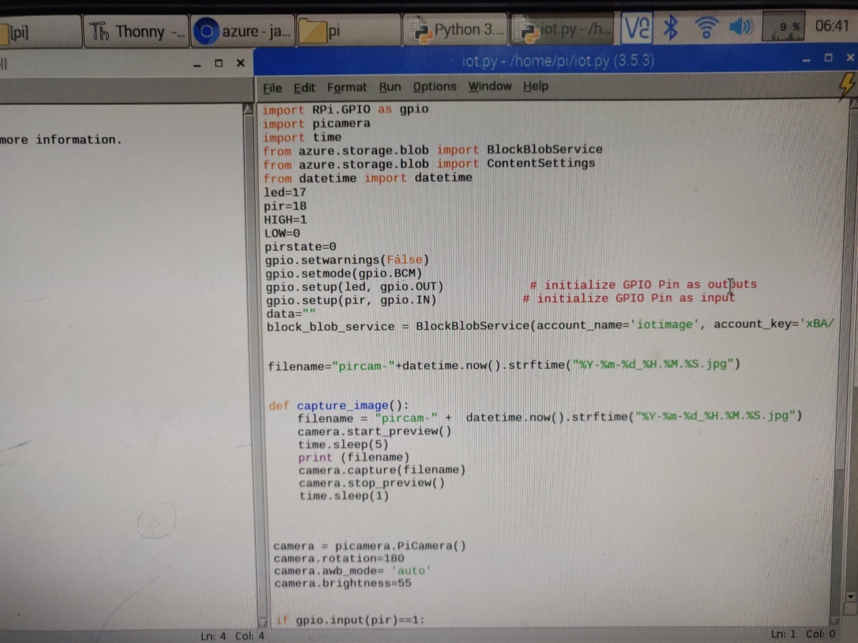
Python IDLE Code

Slide 10
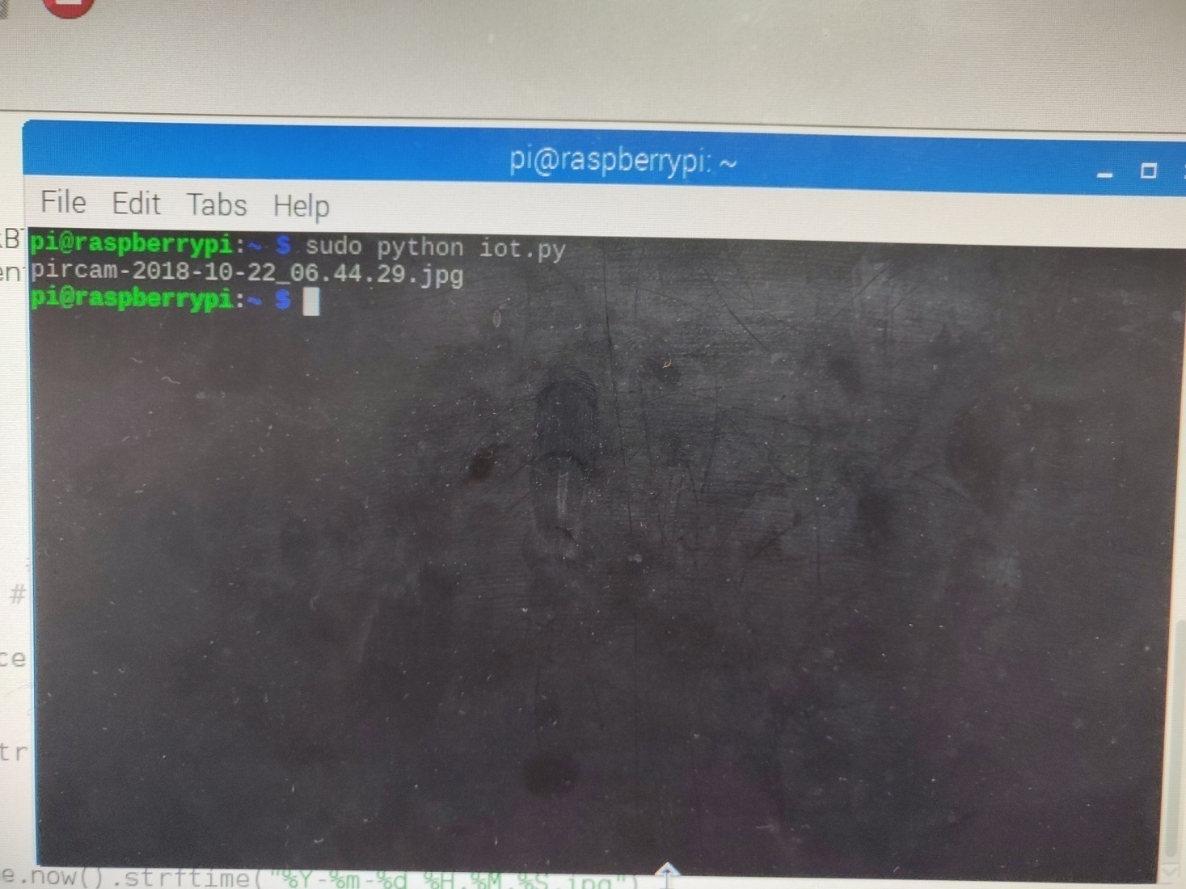
EXECUTION

Slide 11
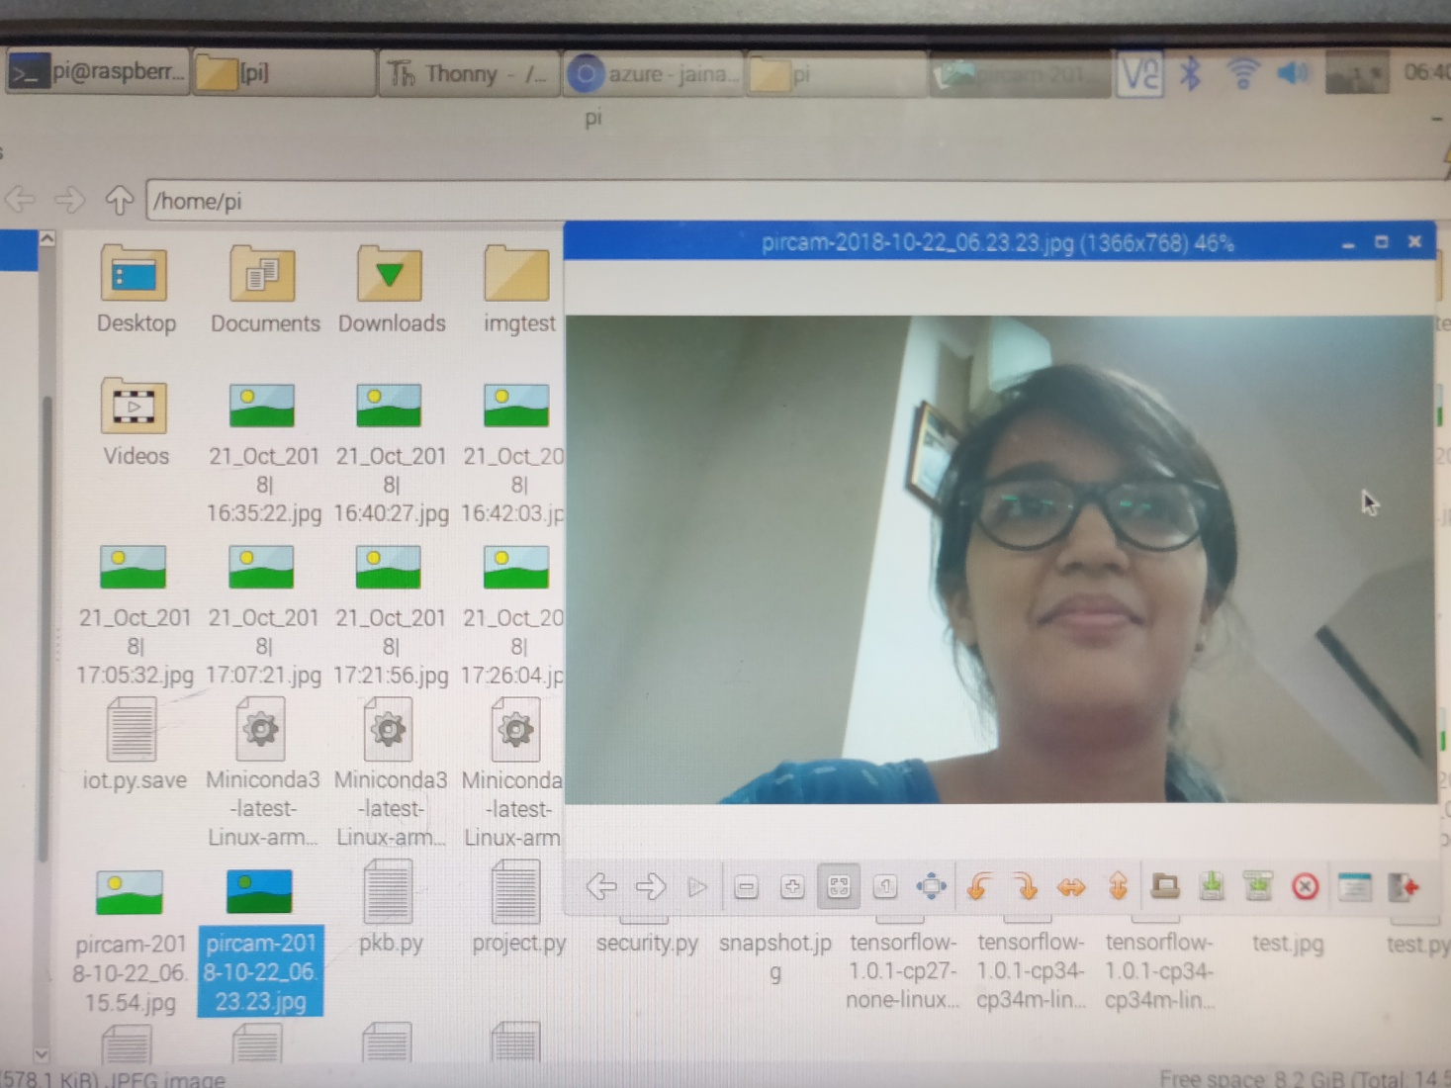
OUTPUT

Slide 12
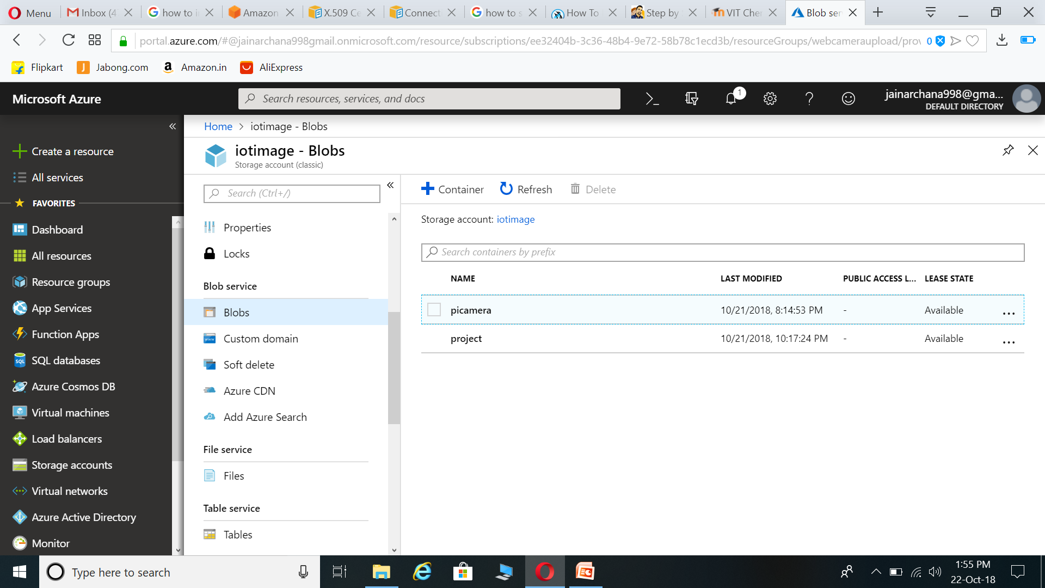
MICROSOFT AZURE

Slide 13
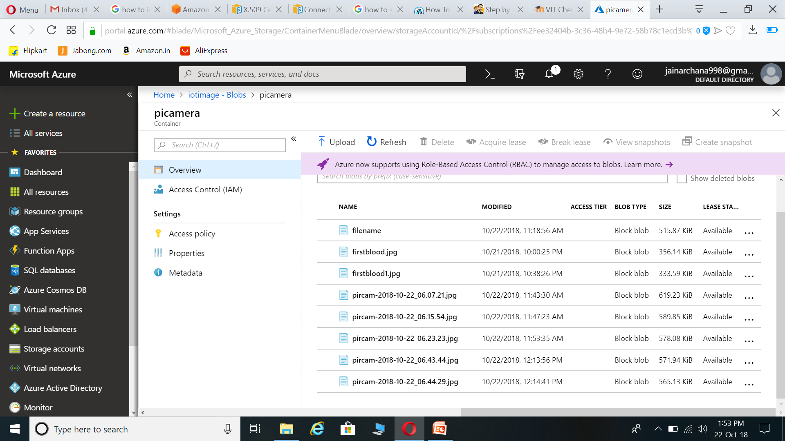
DATA (IMAGES) IN CLOUD

Slide 14
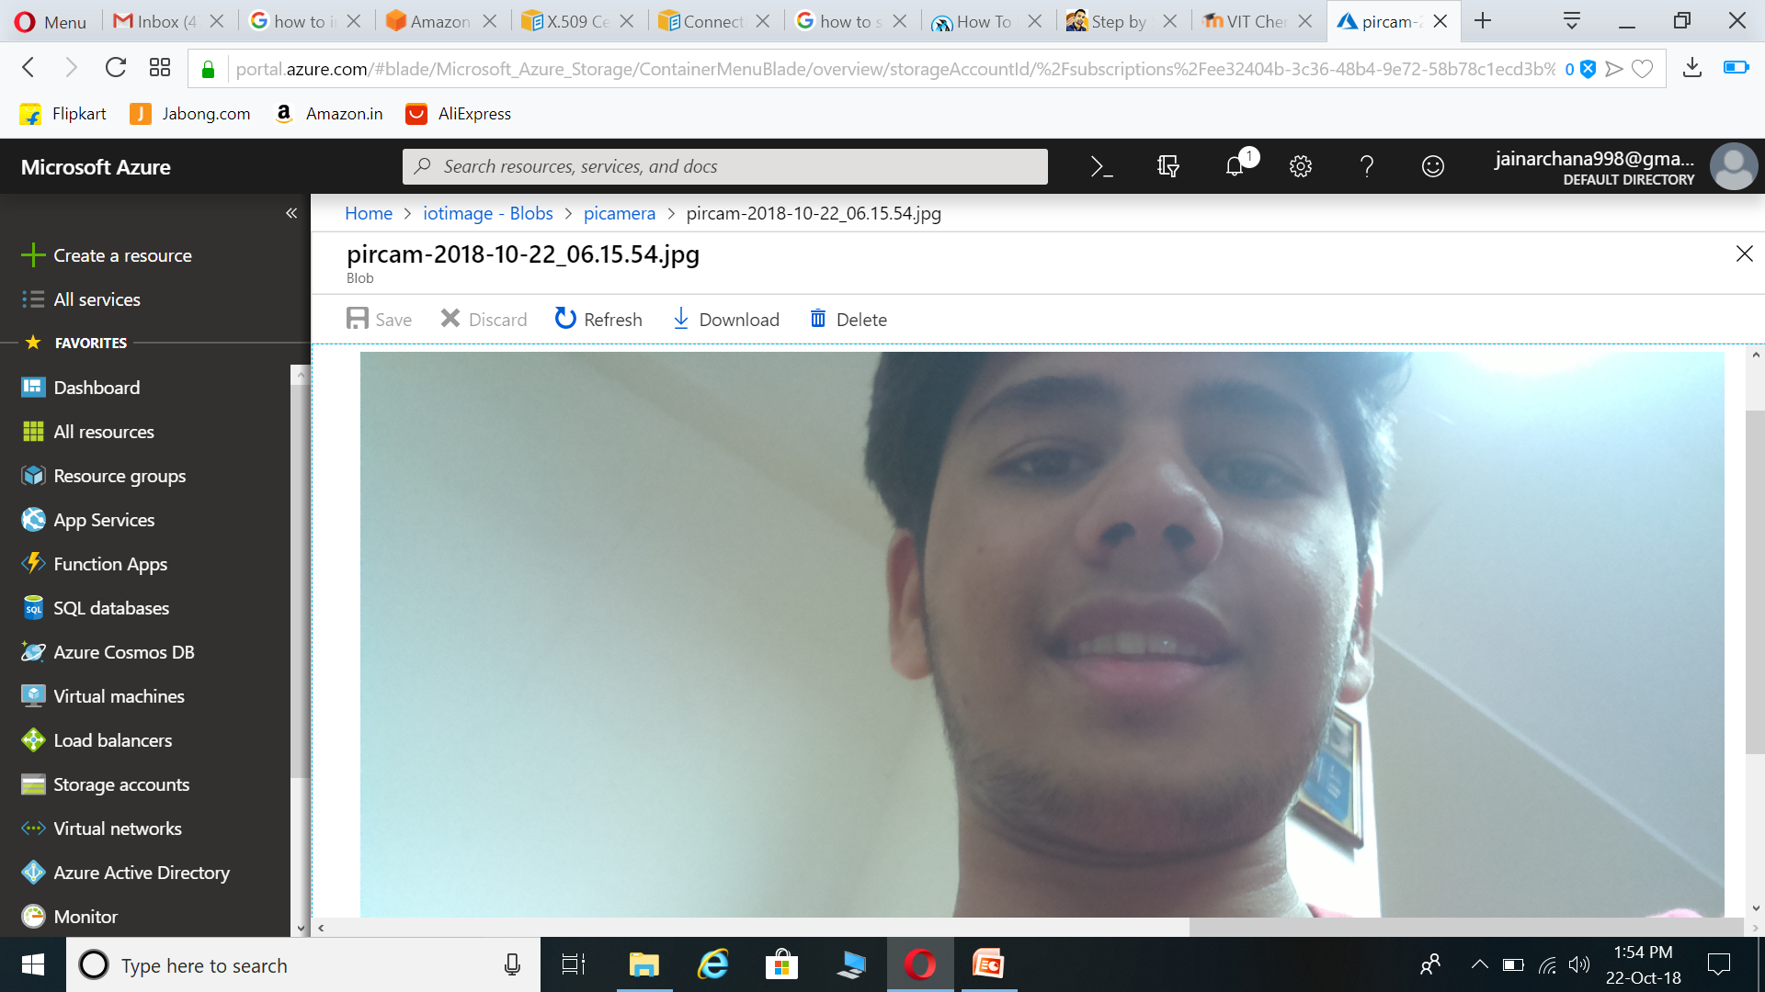
SAMPLE IMAGE

Slide 15
DATA ANALYTICS
OBJECT RECOGNITION:
The image captured will be checked whether it is human image or not. If it is a human image, further processing will be done.
FACE DETECTION AND MATCHING:
The human image detected will be checked for it’s face. The face from the image will be segmented to know if it is an intruder or a family member. Incase, it is an intruder, the alert messages will be generated and mail will be send to the user.

